Slide 1
MATHEMATICAL FOUNDATION FOR COMPUTER SCIENCE
Prepared by: Er. Ankit Kharel
Nepal college of information technology

Slide 2
Graph Theory

Slide 3
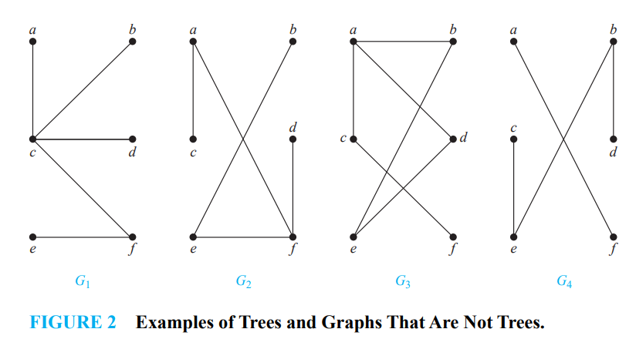
TREES:
Tree is a connected undirected graph with no simple circuits
Because a tree cannot have a simple circuit, a tree cannot contain multiple edges or loops. Therefore any tree must be a simple graph.
G1 and G2 are trees
G3 is not a tree because e, b, a, d, e is a simple circuit in this graph. Finally, G4 is not a tree because it is not connected.

Slide 4
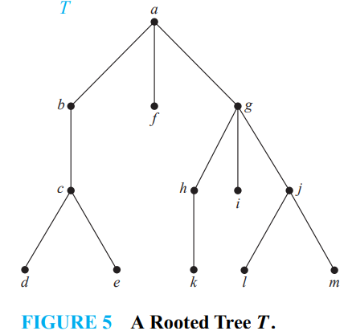
Rooted TREES:
A rooted tree is a tree in which one vertex has been designated as the root and every edge is directed away from the root.
A vertex of a rooted tree is called a leaf if it has no children.
Vertices that have children are called internal vertices.
Vertices with the same parent are called siblings
The ancestors of a vertex other than the root are the vertices in the path from the root to this vertex, excluding the vertex itself and including the root.
The descendants of a vertex v are those vertices that have v as an ancestor

Slide 5
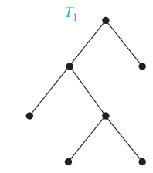
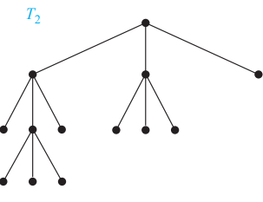
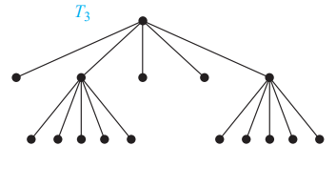
Rooted TREES:
A rooted tree is called an m-ary tree if every internal vertex has no more than m children. The tree is called a full m-ary tree if every internal vertex has exactly m children. An m-ary tree with m = 2 is called a binary tree.
T1 is a full binary tree because each of its internal vertices has two children
T2 is a full 3-ary tree because each of its internal vertices has three children
In T3 each internal vertex has five children, so T3 is a full 5-ary tree

Slide 6
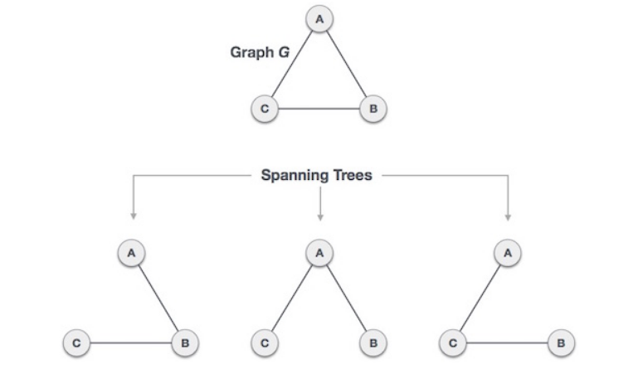
Spanning TREE:
A spanning tree is a subset of Graph G, which has all the vertices covered with minimum possible number of edges. Formally, Let G be a simple graph. A spanning tree of G is a subgraph of G that is a tree containing every vertex of G.
Every connected and undirected Graph G has at least one spanning tree. A disconnected graph does not have any spanning tree, as it cannot be spanned to all its vertices.
A complete undirected graph can have maximum n^{n-2} number of spanning trees, where n is the number of nodes. In the above addressed example, n is 3, hence 3³⁻² = 3 spanning trees are possible.

Slide 7
Spanning TREE:
General Properties of Spanning Tree
A connected graph G can have more than one spanning tree.
All possible spanning trees of graph G, have the same number of edges and vertices.
The spanning tree does not have any cycle (loops).
Removing one edge from the spanning tree will make the graph disconnected, i.e. the spanning tree is minimally connected.
Adding one edge to the spanning tree will create a circuit or loop, i.e. the spanning tree is maximally acyclic.
Spanning tree has n-1 edges, where n is the number of nodes (vertices).
A complete graph can have maximum n^{n-2} number of spanning trees.

Slide 8
Minimum Spanning TREE(MST:
A minimum spanning tree in a connected weighted graph is a spanning tree that has the smallest possible sum of weights of its edges.
A
8
Total cost = 14
A
3
8
B
C
6
B
C
A
6
3
Total cost = 9
Minimum Spanning Tree
B
C
6
A
3
8
Total cost = 11
B
C

Slide 9
Minimum Spanning TREE(MST:
There are two algorithms for finding Minimum Spanning Tree:
(a) Kruskal’s Algorithm
(b) Prim’s Algorithm
(a)KRUSKAL’s ALGORITHM:
The steps for implementing Kruskal's algorithm are as follows:
Remove all the loops and parallel edges if present. In case of parallel edges, keep the one which has the least cost associated and remove all others.
Sort all the edges from low weight to high
Take the edge with the lowest weight and add it to the spanning tree. If adding the edge created a cycle, then reject this edge.
Keep adding edges until we reach all vertices.

Slide 10
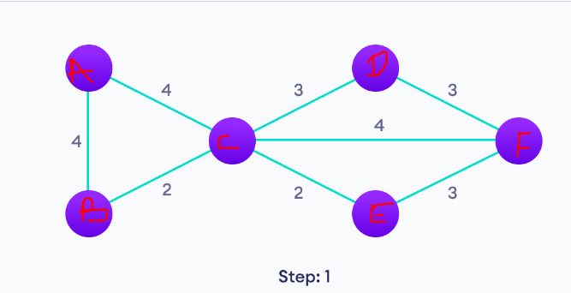
Minimum Spanning TREE(MST:
Find The minimum spanning tree using Kruskal’s Algorithm.
STEP: 1 Sort all the edges in ascending order
{B ,C} | {C ,E} | {D ,C} | {E ,F} | {D ,F} | {B ,A} | {A ,C} | {F ,C}
2 | 2 | 3 | 3 | 3 | 4 | 4 | 4

Slide 11
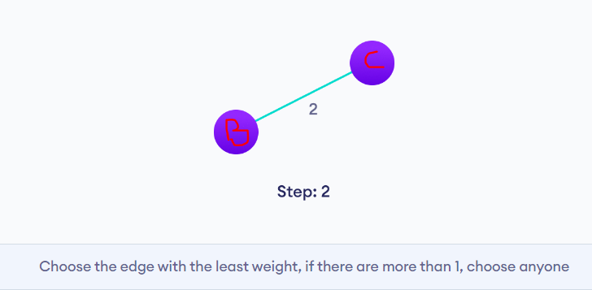
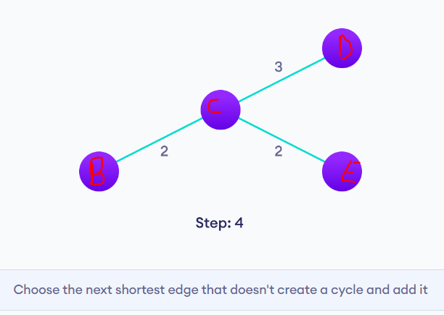
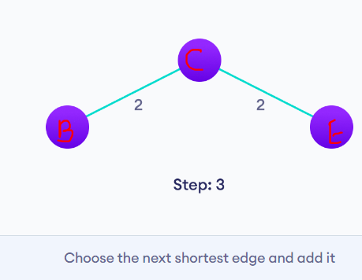
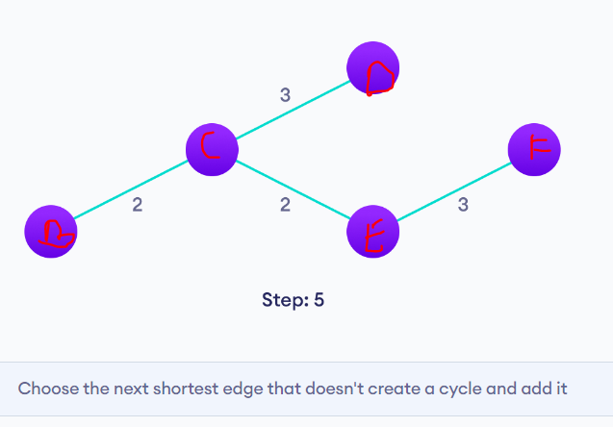

Slide 12
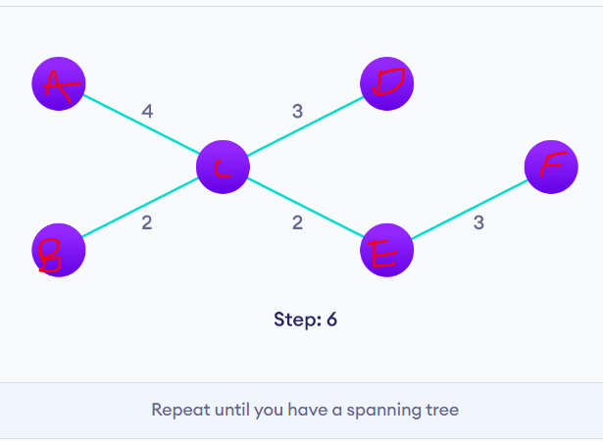

Slide 13
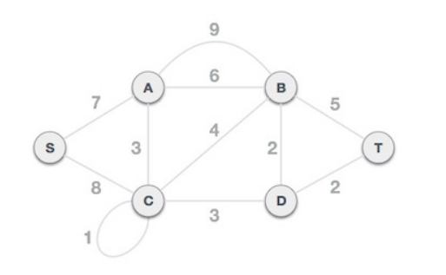
Minimum Spanning TREE(MST:
Find The minimum spanning tree using Kruskal’s Algorithm.
STEP: 1 Remove loops and parallel edges:
{B ,C} | {C ,E} | {D ,C} | {E ,F} | {D ,F} | {B ,A} | {A ,C} | {F ,C}
2 | 2 | 3 | 3 | 3 | 4 | 4 | 4

Slide 14
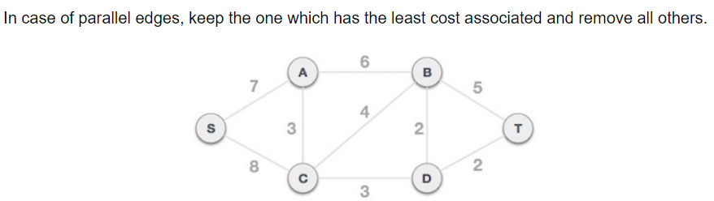
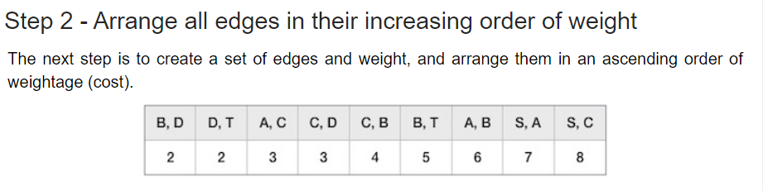
Minimum Spanning TREE(MST:

Slide 15
Minimum Spanning TREE(MST:
There are two algorithms for finding Minimum Spanning Tree:
(a) Kruskal’s Algorithm
(b) Prim’s Algorithm
(a)PRIM’s ALGORITHM:
The steps for implementing Prim’s algorithm are as follows:
Remove all the loops and parallel edges if present. In case of parallel edges, keep the one which has the least cost associated and remove all others.
Choose any arbitrary vertex as a root
Check outgoing edges and select the one with least cost and no cycle
Repeat step(ii) until all vertices are covered.

Slide 16
Minimum Spanning TREE(MST:
Find The minimum spanning tree using Prim’s Algorithm.
Step: 1 If loops and parallel edges are present remove it

Slide 17

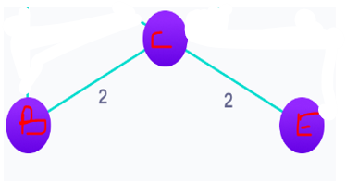
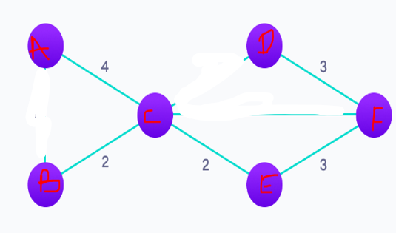
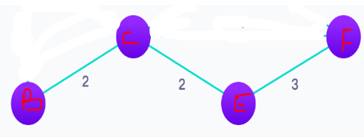
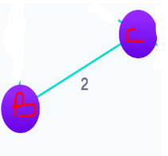
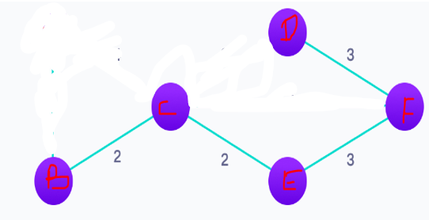
Step: 4
Step: 5
Step: 7
MST
Weight = 14
Step: 3 Choose the smallest weight connected edge
Step: 6

Slide 18
Minimum Spanning TREE(MST:
Find The minimum spanning tree using Kruskal’s Algorithm.

